Slide 1
Watchmen
ENGL 108A

Slide 2
Class Contemplation
If you were an all-powerful being, how long could you keep your sense of morality?
Forever – Slow Decline – Rapid Decline - Gone

Slide 3
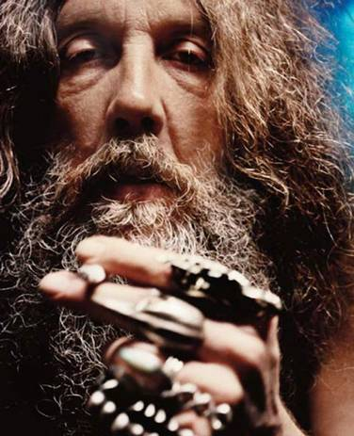
Alan Moore (1953 - )
Northampton – still there today
comics artist: 2000AD, Swamp Thing, Superman/Batman
Watchmen
V for Vendetta
Went underground/alternative (League, Lost Girls, From Hell, Promethea)
Drugs and Wizardry
Experimental Marriage
Still active, still writing League, no royalties for his films.

Slide 4
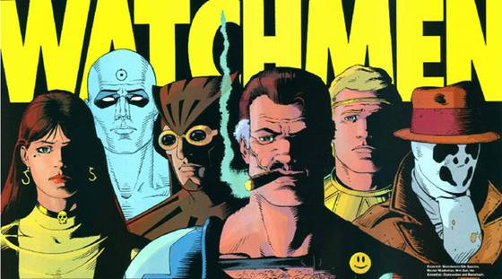
Deconstruction
Watchmen as deconstructive text.
A deconstructive text is one which calls attention to the manner in which meaning is constructed through processes of self-awareness. Satire is a form of deconstruction, as is self-referentiality.

Slide 5
Paradigms
Shifting Paradigms
  Early Superheroes as Power Fantasy
    Often Violent – Batman Kills
  Transition to Rescue Fantasy Post WWII
    The Benevolent Protector
    With Great Power…
  Superman and the Disenchanted

Slide 6
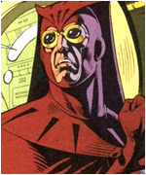
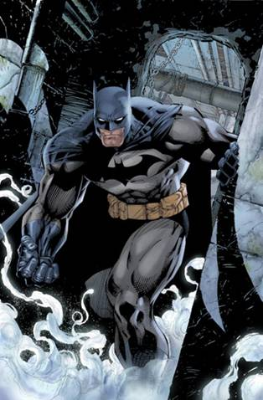
Nite Owl = Batman

Slide 7
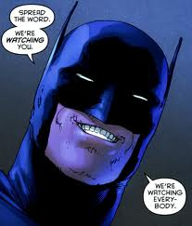
Batman the Fetishist
The Real Batman?
  “Perhaps when considering the manner in which it grips its branch, with two toes in front and the reversible outer toe clutching from behind, we should allow ourselves to pause for a moment, and acknowledge that these same claws must once have drawn blood from the shoulder of Pallas.”
  Costumed Sexuality

Slide 8
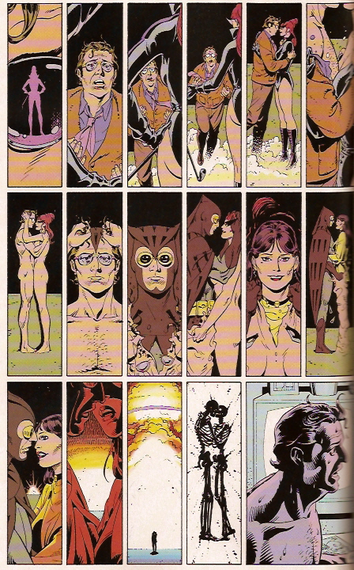
Night Owl
Sexuality and Human/Superhero?

Slide 9
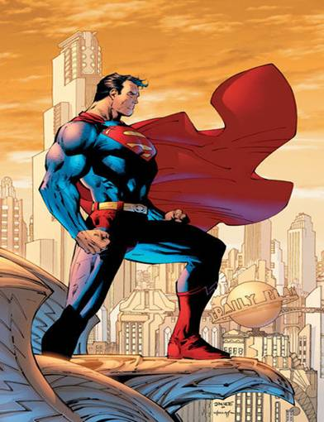

Dr. Manhattan = Superman

Slide 10
The (Super)human Condition
Man and Superman
  Interspecies Marriage
    Janey
    Laurie
  Clothes Make the Man
  Termites
  Internal Dichotomy
  Hero with a Heart of Mild Amusement

Slide 11
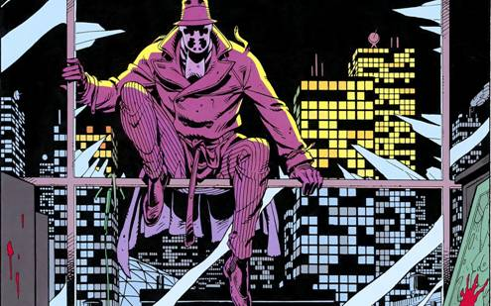
The Other Superman
Superman II
  Rorschach as Soft SF Moral Obstinacy
  Transition as corruption of Superman
  Foil to Manhattan
  Consequences in Real World

Slide 12
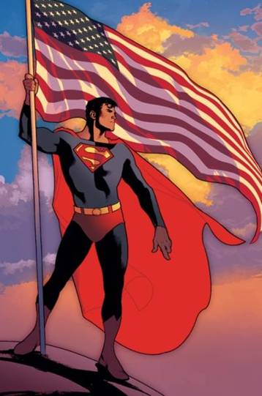
A Sense of Consequence
Politics of Superman
  Weapon of Mass Destruction
  Vietnam
  Social Anxiety
  Human Compatibility
  Machiavellian Pawn
Good Luck with That

Slide 13
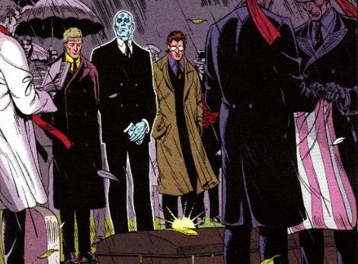
The Value of Heroism
Justice League?
  Too little
    Dead, Corrupt, In Cahoots, Absent
  Too late
  Replaced by Pirates
  The Meek
    Why?

Slide 14
A Formal Concern
The Superhero is always a figure of empowerment, but Watchmen explores this idea of the Superhero’s effectiveness in the world.
Theme of Order vs. Chaos
  Character
  Manipulation of Comics Form
  Thematic Threads

Slide 15
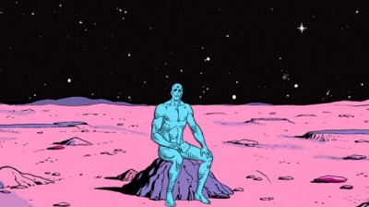
Christ Allusions
Manhattan
  “Judge of All the Earth”
  Godlike Power
  Resurrected from the dead
  Walks on water
  Creator of life

Slide 16
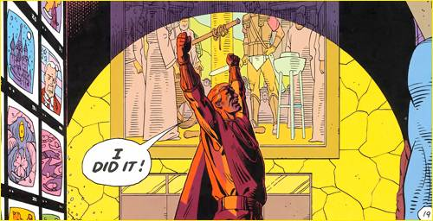
Christ Allusions II
Veidt
  Savior of all mankind
  Watches from on high
  Is seen crucified at climax of achievement
  Transcendence of Bullet

Slide 17
Veidt
11:1 “Computer animations imbue even breakfast cereals with an hullucinagenic futurity; music channels process information-blips, avoiding linear presentation, implying limitless personal choice… These reference points established, and emergent worldview becomes gradually discernible amidst the media’s white noise. This jigsaw-fragment model of tomorrow aligns itself piece by piece, specific areas necessarily obscured by indeterminacy. However broad assumptions regarding this postulated future may be drawn. We can imagine its ambience. We can hypothesize its psychology. In conjunction with massive forecasted technological acceleration approaching the millennium, this oblique and shifting cathode mosaic uncovers the blueprint for an era of new sensations and possibilities. An era of the conceivable made concrete…and of the casually miraculous.
Causality and Order
Repetition
Expansion of consciousness
  Contradiction?

Slide 18
Rorschach the Optimist
1:24 “Why does one death matter against so many? Because there is good and there is evil, and evil must be punished. Even in the face of Armageddon I shall not compromise in this.”
  Subject to Irony and Foreshadowing.
  12:20 “No. Not even in the face of Armageddon. Never compromise.”
2:25 “Nothing is hopeless. Not while there’s life.”
  Foreshadows both Jon’s return to Earth.
  Adds implication to Rorschach’s demise.

Slide 19
Rorschach the Pessimist
6:26 “Looked at sky through smoke heavy with human gat and God was not there. The cold, suffocating dark goes on forever, and we are alone. Live our lives, lacking anything better to do. Devise reason later. Born from oblivion; bear children, hell-bound as ourselves; go into oblivion. There is nothing else. Existence is random. Has not pattern save what we imagine after staring at it for too long. No meaning save what we choose to impose. This rudderless world is not shaped by vague metaphysical forces. It is not God who kills the children. Not fate that butchers them or destiny that feeds them to the dogs. It’s us. Only us.”

Slide 20
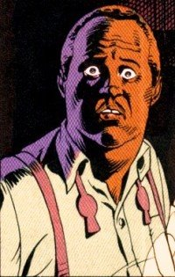
Contagious Philosophy
Mal, the Psychiatrist:
6:28 “I sat on the bed. I looked at the Rorschach blot. I tried to pretend it looked like a spreading tree, shadows pooled beneath it, but it didn’t. It looked more like a dead cat I once found, the fat, glistening grubs writhing blindly, squirming over each other, frantically tunneling away from the light. But even that is avoiding the real horror. The horror is this: in the end, it is simply a picture of empty meaningless blackness. We are alone. There is nothing else.”
  Enough to ruin a dinner party.

Slide 21
I am large, I contain multitudes
How to reconcile Rorschach’s Philosophy:
  Rorschach as Whitman
  Rorschach as Hamlet
  Rorschach as Crazy Person
  Rorschach as Rorschach
How to be annoying and complicate things further:
  Rorschach as product of predictable system
  Rorschach as anti-christ

Slide 22
Manhattan
4:19 “He suits the climate here: the madness the pointless butchery. As I come to understand Vietnam and what it implies about the human condition, I also realize that few humans will permit themselves such an understanding. Blake’s different. He understands perfectly…and he doesn’t care.”
  Enough to ruin a dinner party?

Slide 23
Life’s a fix for the Eternal Fatalist
Fatalism vs. Determinism
4:27 “A world grows up around me. Am I shaping it, or do its predetermined contours guide my hand? In 1945, the bombs are falling on Japan, the cogs are falling on Brooklyn, seeds of the future sown carelessly. Without me, things would have been different. If the fat man hadn’t crushed the watch, if I hadn’t left it in the test chamber… Am I to blame then? Or the fat man? Or my father for choosing my career? Which of us is responsible? Who makes the world? Perhaps the world is not made. Perhaps nothing is made. Perhaps it simply is, has been, will always be there… A clock without a craftsman.”
Que Sera Sera
  Allows Comedian to murder pregnant woman
  Allows Kennedy to be assassinated
  Would allow world to end

Slide 24
Let’s make a difference!
Switch to Determinism
9:27 “We gaze continually at the world and it grows dull in our perceptions. Yet seen from another’s vantage point, as if new, it may still take the breath away.”
9:28 “Come…dry your eyes, for you are life, rarer than a quark and unpredictable beyond the dreams of Heisenberg; the clay in which the forces that shape all things leave their fingerprints most clearly.”

Slide 25
Superman’s Full of Crap
High Level of Affectation
  Guilt
  Love
  Anger
  Interest
Retreat
  9:14 “Life could have flourished here then, but Mars did not choose life. It chose this. It’s called Chaotic Terrain.”
  12:27 “I’m leaving this galaxy for one less complicated.”
Manhattan is a product of human science himself, a watch built by a watchmaker

Slide 26

Fearful Symmetry
Tyger, Tyger
Chapter as perfect mirror
  Rorschach is primary concern
  Veidt at center of mirror
  “It’s Karma, man. Everything evens out eventually. Everything balances.”
Repetition of Happy Face, Lovers’ Shadows, etc.
Repetition of Chapter Motif
Repetition of panel structuring
Laurie becomes her Father
Every small background clock is at 11:55
Pirate story as thematic resonance
  Concern with hidden agenda, manipulation
Quis Custodiet Ipsos Custodes
  Never fully uttered

Slide 27
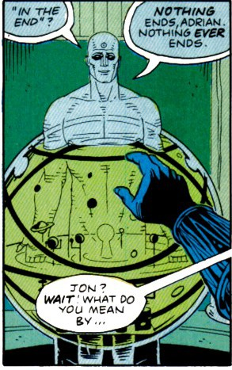
Fearful Asymmetry
Worst Comedian Ever
Alexander Cheats
11:22
Good and Evil Conflated
“If only I had known, I should have become a watchmaker.”
Nothing ends

Slide 28
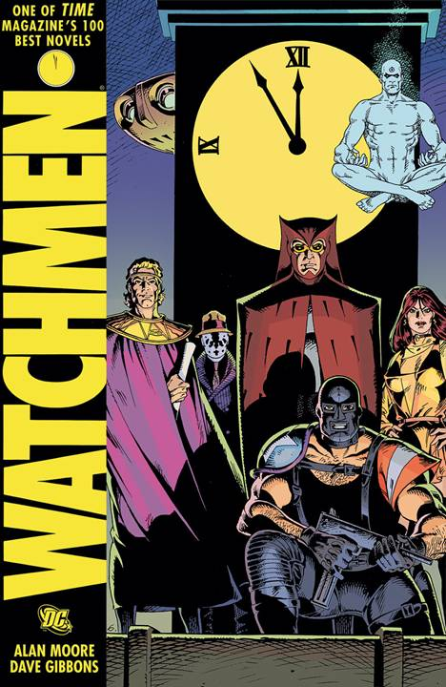
GD3
Lets play grade 3 reading comprehension:
What is Watchmen’s Ultimate commentary on the role of superheroes? The moral of the story is ________.
Come to a consensus in your group (a unified argument) and justify it using evidence from the text.

